Slide 1
CMOS Analog and mixed Signal IC Design
Final Project

Slide 2
Submitted to
Dr.Bharat Bhushan
Assistant Professor
Electronics and Communication Engineering
Submitted by
R. Srihari Kartheek - AP23110020072

Slide 3
Introduction
Design and Simulation of Quadrature CMOS Relaxation Oscillator Using Cadence
A relaxation oscillator is an electronic circuit that generates periodic waveforms by repeatedly charging and discharging a capacitor between two threshold voltage levels. Unlike LC oscillators, it does not require inductors, making it more suitable for integrated circuits.
CMOS relaxation oscillators are widely used due to:
  low power consumption
  compact design
  easy integration in VLSI systems
In this project, a quadrature relaxation oscillator is designed, which produces two outputs with a phase difference, making it useful in communication and signal processing applications.

Slide 4
Working Principle
The operation of the relaxation oscillator is based on:
  constant current charging/discharging of capacitors
  switching action of CMOS transistors
  regenerative feedback through cross-coupled structures
Initially, one capacitor charges while the other discharges.
Once a threshold voltage is reached:
  the switching transistors flip the state
  the current direction changes
  the process repeats continuously
This results in a periodic waveform.
In the quadrature design, two such oscillators are coupled so that:
  one produces in-phase (I) signal
  the other produces quadrature (Q) signal

Slide 5
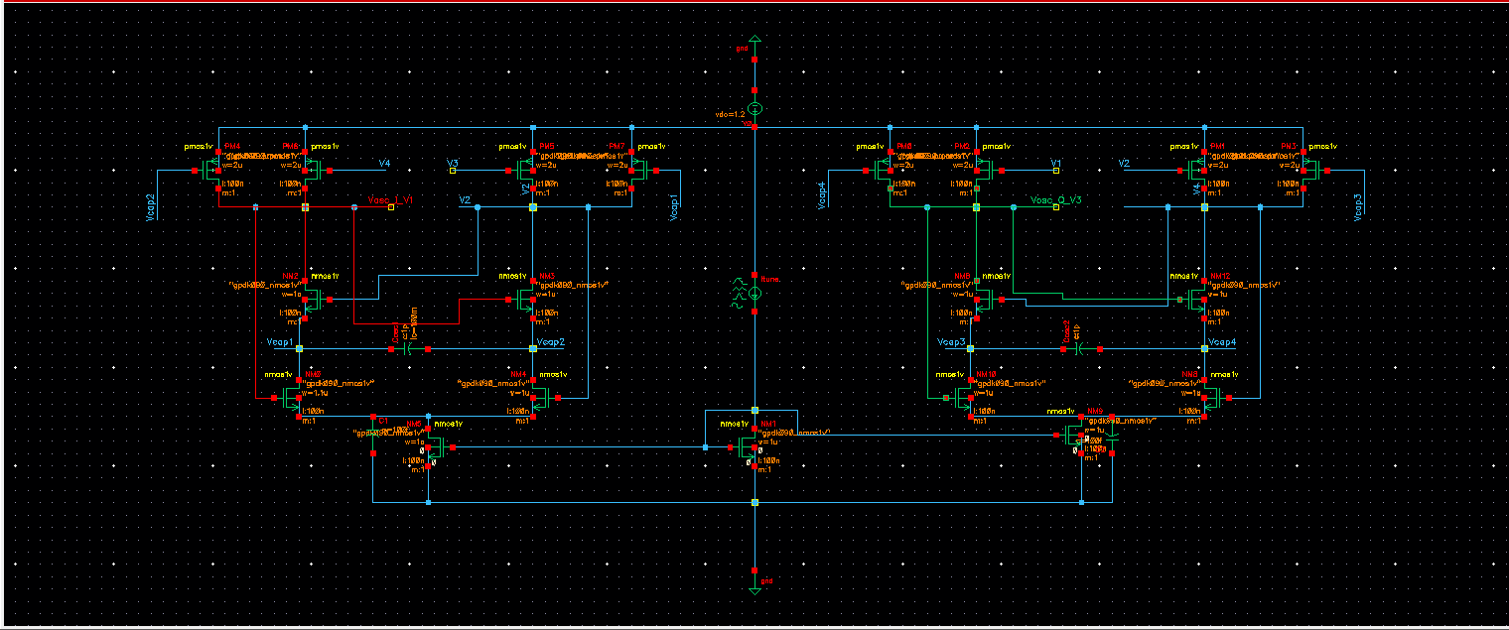
Circuit Design

Slide 6
Circuit Design
The implemented circuit consists of:
  two identical oscillator blocks (left and right)
  cross-coupled NMOS transistors for switching
  PMOS transistors acting as active loads
  capacitors (Cosc, C1, C2) for timing control
  a tail current source (Itune) for biasing
  supply voltage (VDD = 1.2V)
Important node names:
  I-path: Vosc_I_V1 and V2
  Q-path: Vosc_Q_V3 and V4
  internal nodes: Vcap1, Vcap2, Vcap3, Vcap4
The symmetry of the circuit ensures balanced operation and proper phase shift between outputs.

Slide 7
Cadence Implementation
The circuit was designed using:
  Cadence Virtuoso Schematic Editor
  Technology library: GPDK90
MOSFET parameters:
  Channel length (L) = 100 nm
  Width (W) chosen based on switching requirements
Simulation setup:
  Analysis type: Transient (tran)
  Stop time: 10 ns
  Supply: 1.2 V DC source
  Bias current: provided using current source (Itune)
Initial challenges such as:
  illegal bus naming
  DC convergence issues
were resolved using:
  proper node naming
  correct bulk connections
  transient startup configuration

Slide 8
Simulation Results (Single-Ended)
The obtained waveforms show successful oscillation.
Observations:
  Output signals:
    Vosc_I_V1
    V2
    Vosc_Q_V3
    V4
  Voltage swing:
    approximately 0.8 V to 1.2 V
  Nature of waveform:
    non-sinusoidal (relaxation type)
    smooth charging and rapid discharging
  Phase behavior:
    I and Q outputs show phase difference
This confirms that the oscillator is functioning correctly.

Slide 9
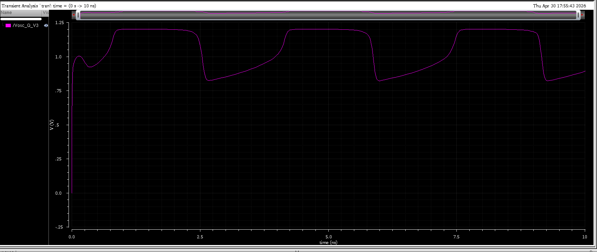
Vosc_Q_V3

Slide 10
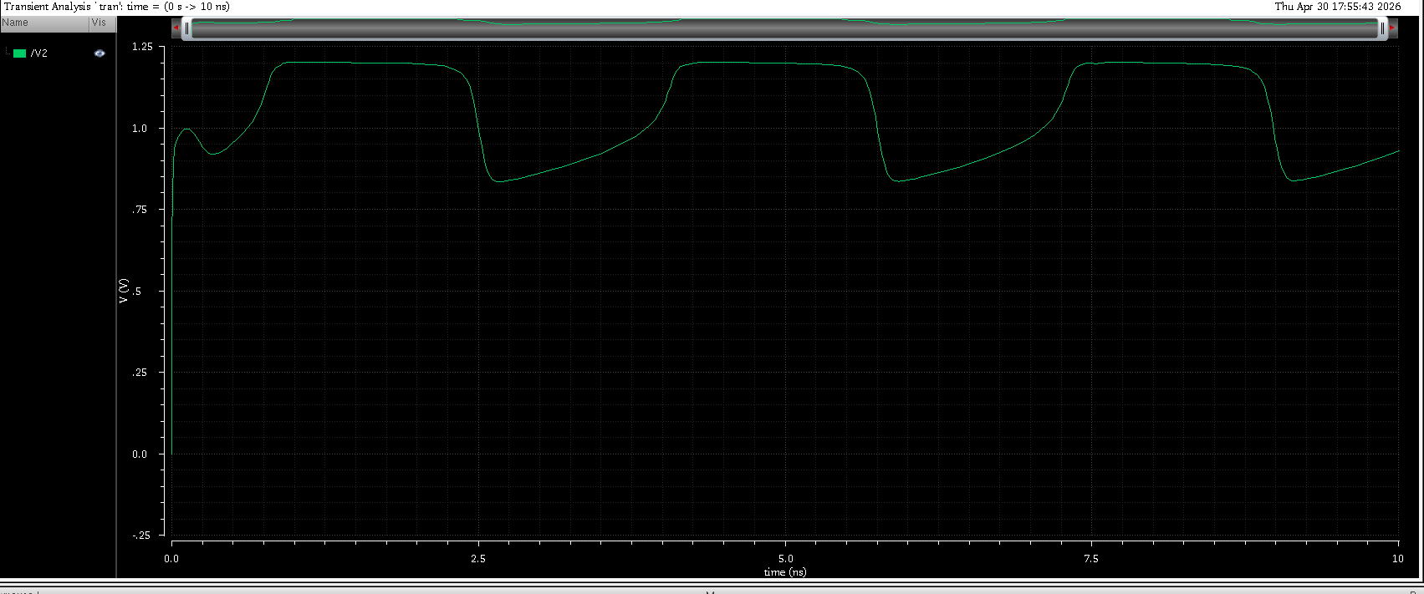
V2 Plot

Slide 11
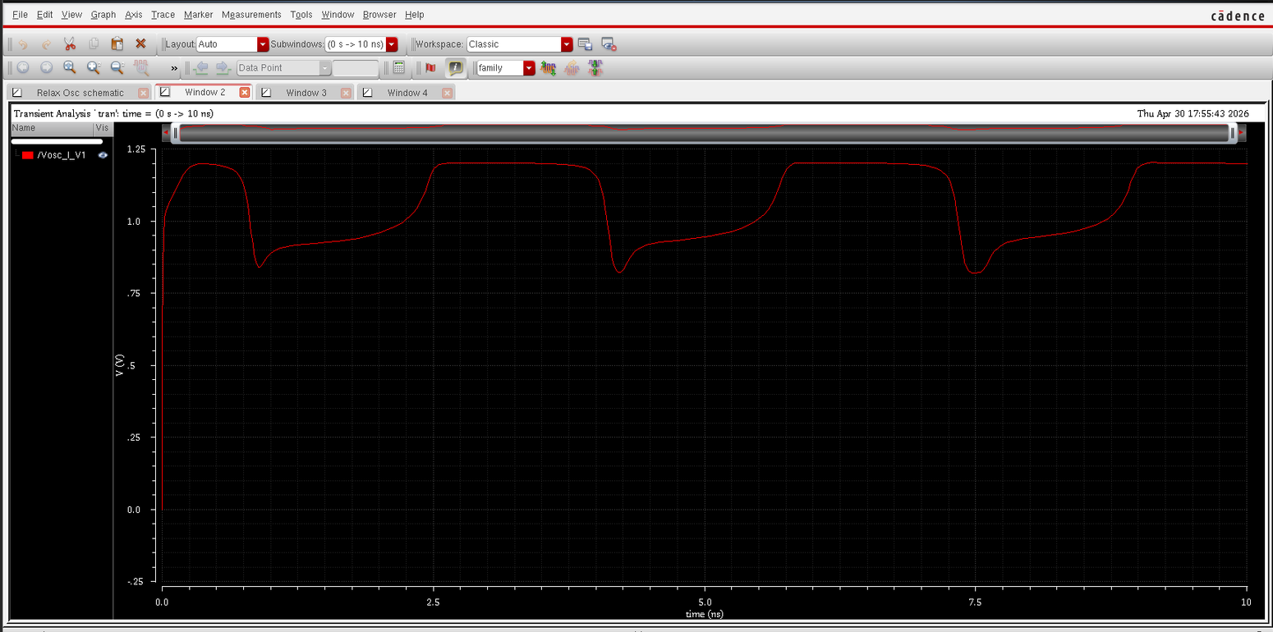
Vosc_I_V1

Slide 12
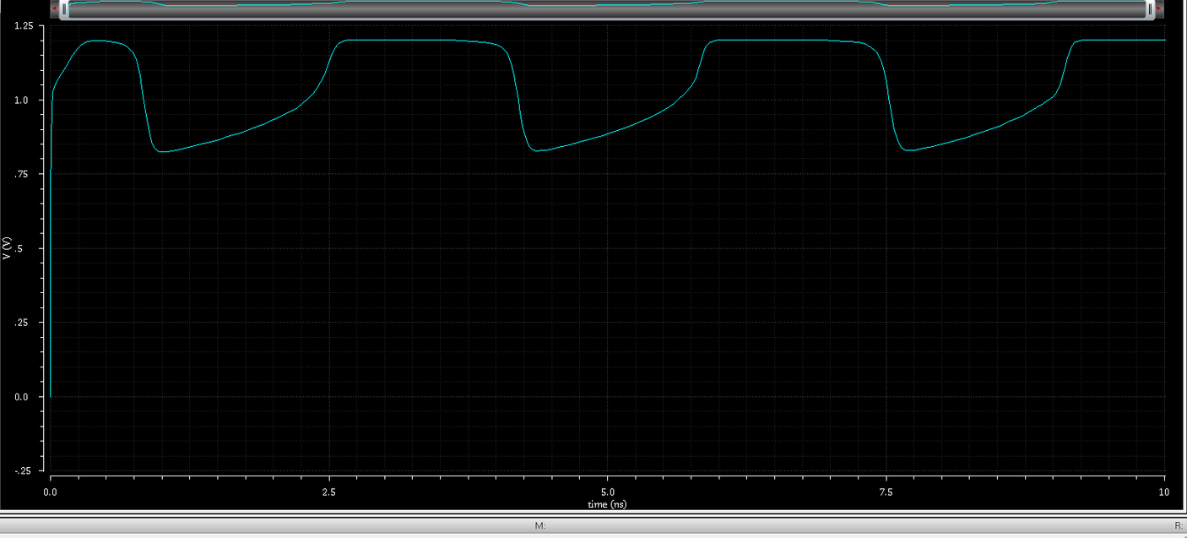
V4 Plot

Slide 13
Differential Output Analysis
Differential outputs were obtained by subtracting complementary nodes:
  I-phase:
  Vdiff_I = Vosc_I_V1 − V2
  Q-phase:
  Vdiff_Q = Vosc_Q_V3 − V4
Observations from differential waveform:
  signal is centered around 0 V
  improved amplitude symmetry
  peak-to-peak swing ≈ ±0.35 V
  reduced common-mode noise
Differential output is preferred because:
  it improves noise immunity
  provides better signal integrity
  widely used in communication systems

Slide 14
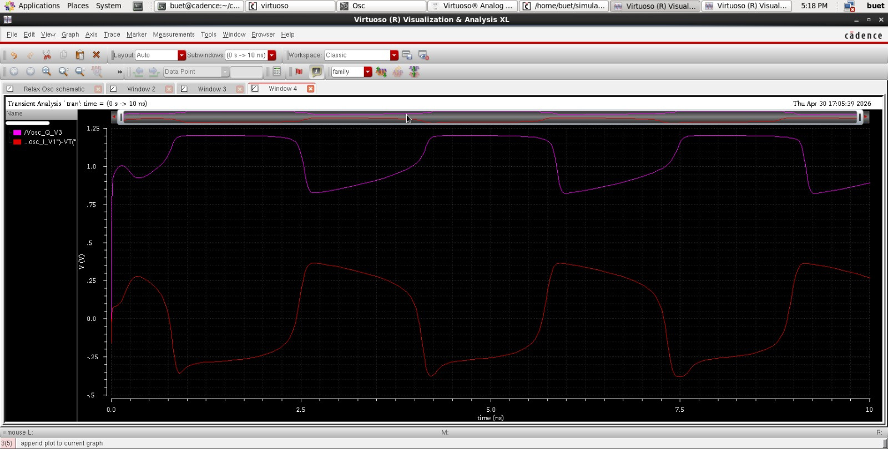
Differential output V0sc_I_V1 - V2

Slide 15
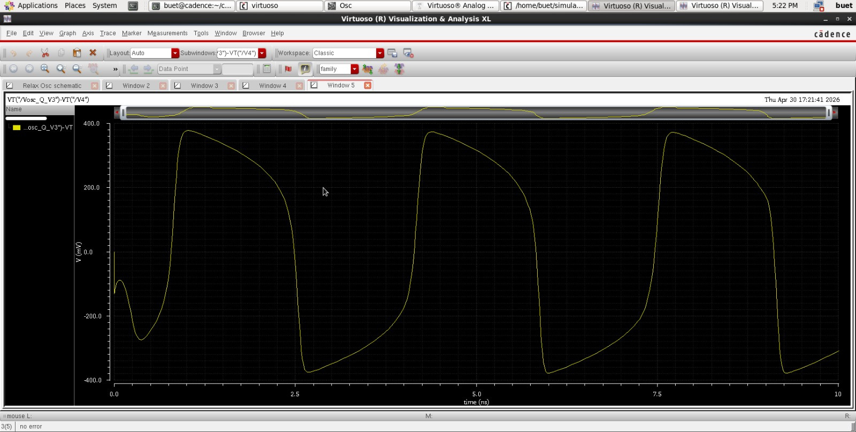
Differential Output
Vosc_Q_V3 - V4

Slide 16
Conclusion and Future Work
Conclusion:
  Successfully designed a quadrature CMOS relaxation oscillator
  Achieved stable oscillation using GPDK90
  Generated both single-ended and differential outputs
  Verified quadrature behavior through simulation
Advantages:
  simple CMOS implementation
  low power consumption
  no inductors required
Future Scope:
  improve output swing
  optimize transistor sizing
  reduce power consumption
  perform layout design and post-layout simulation

Slide 17
Thank You

